Slide 1
Supplemental Slides for the PSA Grower Training Curriculum:
Agricultural Water Definitions
SUPPLEMENTAL MATERIAL
Notes:
The following slides were developed to highlight the definition of ‘agricultural water’, and frame it in the context of on-farm water use. These supplemental slides are best used at the beginning of Module 5.1: Production Water.

Slide 2
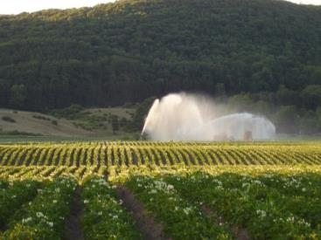
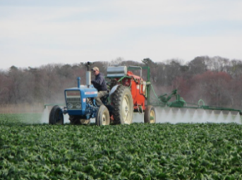
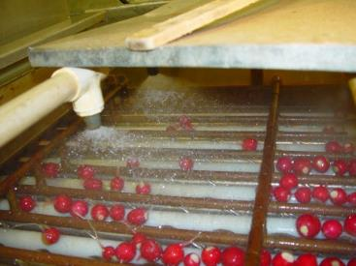
Helpful Definitions
Agricultural water must be safe and of adequate sanitary quality for its intended use.
  Agricultural water means water used in covered activities on covered produce where water is intended to, or is likely to, contact covered produce or food contact surfaces.
  Covered produce means produce that is subject to the requirements of the Produce Safety Rule. The term “covered produce” refers to the harvestable or harvested part of the crop.
SUPPLEMENTAL MATERIAL
Notes:
Note: These slides can be used in Module 5.1, after the slide titled Agricultural Water Quality.
The definitions on the slide, defined in § 112.3(c), are critical to understanding the scope of what is covered under these criteria.
Water that does not meet the definition of agricultural water is not covered by water quality criteria in the FSMA Produce Safety Rule. For example, water used for drip or furrow irrigation in apple orchards would not be considered agricultural water, as long as the water does not contact the apples. That same water would be considered agricultural water if it were used to mix protective sprays that were then applied directly to the apples.

Slide 3
Agricultural Water Example
SUPPLEMENTAL MATERIAL
Notes:
Note: Animation included in slide.
This slide can be used to work through the process of describing when water on the farm meets the definition of Agricultural Water. It adds a level of complexity by highlighting when one type of squash is covered and one is not. This provides another opportunity to discuss covered produce and how covered produce relates to the agricultural water determination. Depending on teaching style and audience, this slide and/or the photographic slides that follow can be used to demonstrate this learning concept.

Slide 4
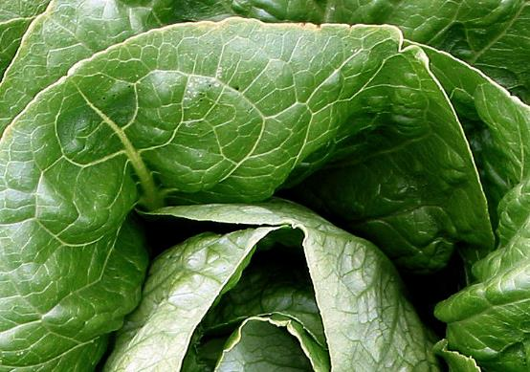
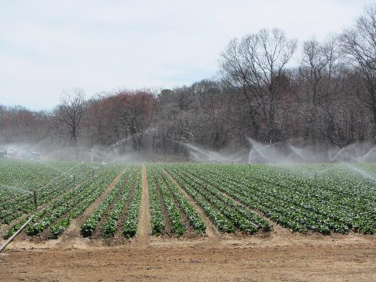
Is this Agricultural Water?
Lettuce
Overhead irrigation
SUPPLEMENTAL MATERIAL
Notes:
Answer: Yes. Water is intended to, or is likely to, contact covered produce (leafy greens).

Slide 5
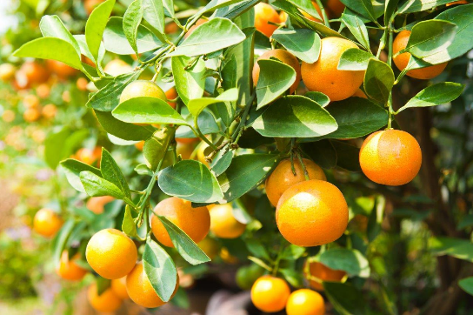
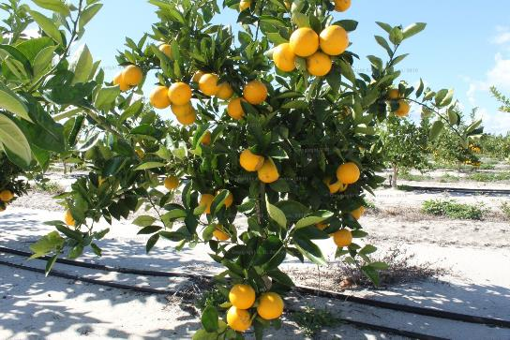
Is this Agricultural Water?
Citrus
Drip irrigation
SUPPLEMENTAL MATERIAL
Notes:
Answer: No. In this scenario, water is NOT intended to, or likely to, contact covered produce (oranges).
Discussion: In the event that the drip irrigation is not functioning properly, such as a broken emitter that sprays water up into the canopy of the tree, the water may contact the crop. This is not likely to occur if the water distribution system is maintained in good condition and functioning properly because the fruit is in a tree above the drip irrigation zone.

Slide 6
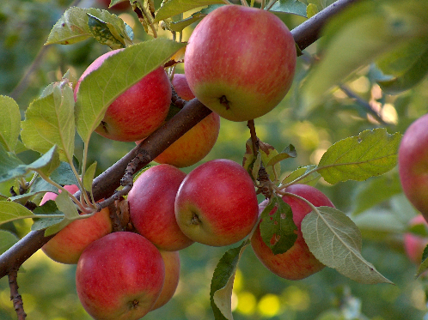
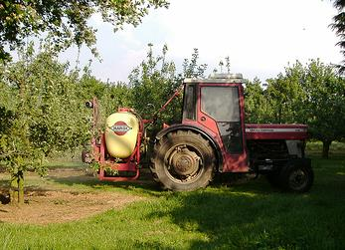
Is this Agricultural Water?
Apples
Pesticide application
SUPPLEMENTAL MATERIAL
Notes:
Answer: Yes. Water is intended to, or is likely to, contact covered produce (apples) through the water used during pesticide applications.

Slide 7
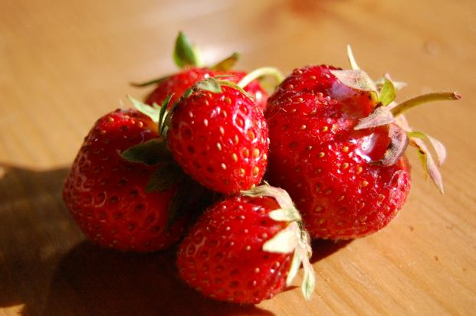
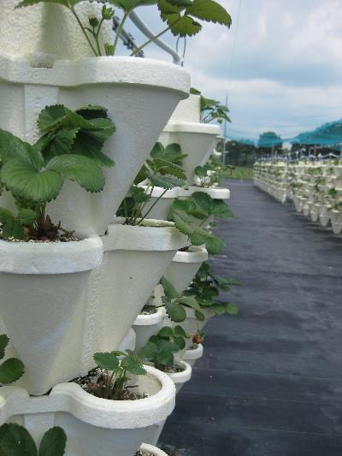
Is this Agricultural Water?
Strawberries
Trickle
SUPPLEMENTAL MATERIAL
Notes:
Answer: Not likely. Water is NOT intended to, or likely to, contact covered produce (strawberries).
Discussion: In this system, the water is delivered to the growing pots via tubing to the root system only. However, on this farm, several growing pots were not draining properly and water was dripping down onto plants below.

Slide 8
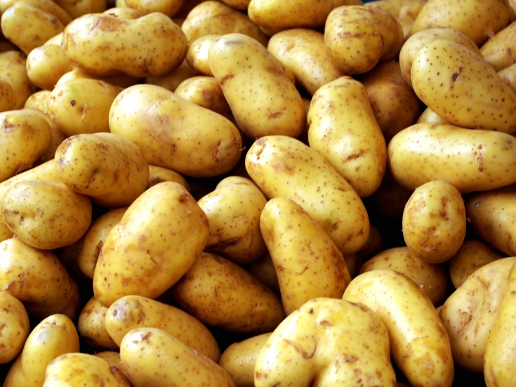
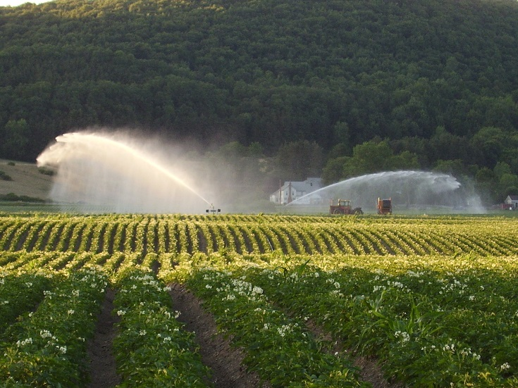
Is this Agricultural Water?
Potatoes
Overhead Irrigation
SUPPLEMENTAL MATERIAL
Notes:
Answer: No. Potatoes are on the ‘rarely consumed raw’ list and not considered to be ‘covered produce’.

Slide 9
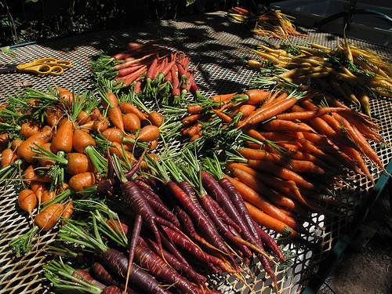
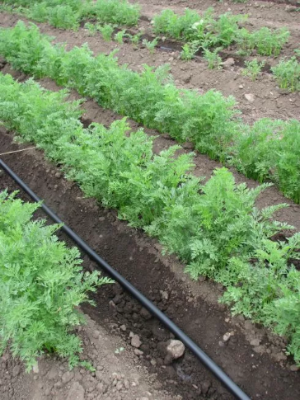
Is this Agricultural Water?
Carrots
Drip irrigation
SUPPLEMENTAL MATERIAL
Notes:
Answer: Yes. Water is intended to, or is likely to, contact covered produce (carrots). Even though drip irrigation is used, the water is likely to contact the carrots since they are a root crop.

