Slide 1
Information to Share with Laboratories:
FSMA Produce Safety Rule
Water Quality Testing Requirements for Farms
Excerpted and adapted from a webinar the Produce Safety Alliance prepared with Michigan State University for presentation 22 June 2018
The Webinar was influential in development of lists and maps of water testing laboratories for farms in several States
Maps or lists of labs for ag water testing
Colorado lab selection guidance
Hawaii list
Iowa map, list
Kansas map
Maryland list
Massachusetts list
Michigan fact sheet with map and list
Minnesota map
Missouri map
New Hampshire list
New Jersey map
North Carolina list
Virginia map, list
Washington map
Wisconsin map
Version 1/31/2019

Slide 2
How to Create a Water Lab Map for Farms in Your Area
Webinar with Michigan State University
22 June 2018
Marissa Schuh, Phil Tocco, Ben Phillips
Michigan State University
Extension
Don Stoeckel
Cornell University
Midwest Region Extension Associate
Notes:
This excerpt should occupy about 20 minutes

Slide 3
Background
Many farmers are interested in testing their water to meet both buyer and FSMA Produce Safety Rule (PSR) requirements
Farmers may need help identifying both the tests they need and labs that can perform these tests
Many supporting organizations can help farmers understand water testing requirements and identify labs that can perform the required tests
Some laboratories are not aware of buyer (audit) or PSR requirements leading to potential for inaccurate recommendations or the wrong tests being performed

Slide 4
Background
Some laboratories are not aware of buyer (audit) or PSR requirements leading to potential for inaccurate recommendations or the wrong tests being performed
As one way to address this concern, the following slides were excerpted and updated from a webinar that was presented on June 22, 2018
  The excerpt is for potential use as educational materials
  The full webinar and associated Standard Operating Procedure can be found on the NECAFS Clearinghouse web site
Notes:
URL: https://www.uvm.edu/extension/necafs/clearinghouse/

Slide 5
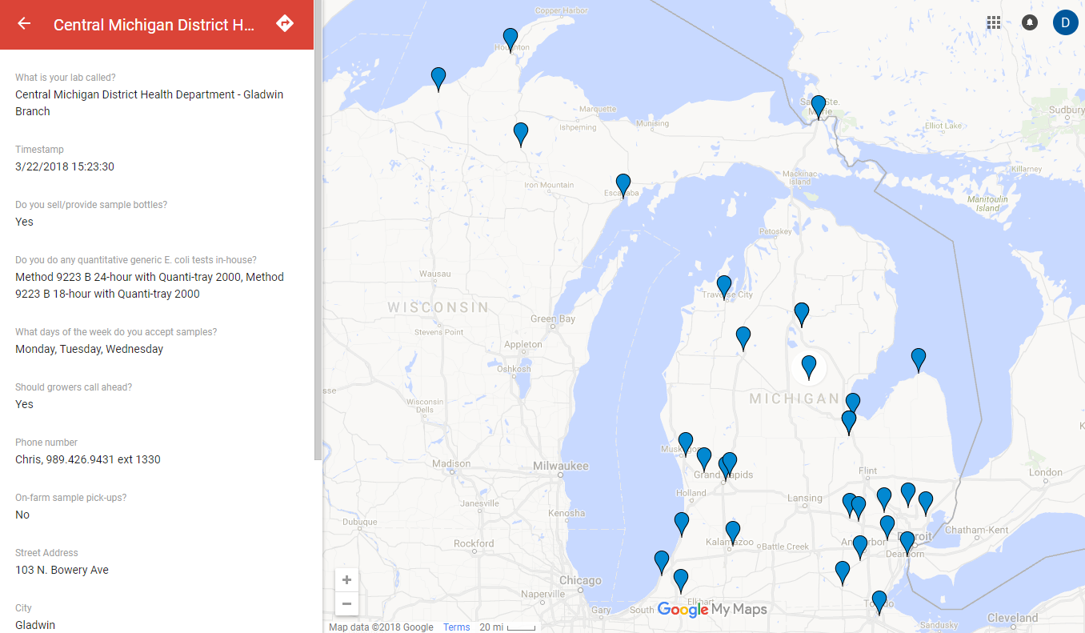
Webinar Vision
Develop an easy and functional resource for farmers
Share understanding of what farmers need from labs

Slide 6
Process (covered in webinar)
MSU developed a standard operating procedure (SOP) based on process used for their original map
  Identifies analysis laboratories
  Collects data from the laboratories
  Compiles the data into a Google map
Share the standard operating procedure
  Housed at the NECAFS Clearinghouse
Explain the SOP and discuss opportunities for collaboration

Slide 7
4. Since you’re talking to the lab anyway …
It might be helpful to share some basic information about current (2019) requirements in the
FSMA Produce Safety Rule
Information such as the following slides can be useful when talking with labs. These slides can be shared to help explain some basic background information.
Notes:
The following slides are available for your use, in whole or in part, during discussions with laboratories that are interested in knowing more about the FSMA Produce Safety Rule (current, June 2018) language and how regulatory monitoring under the FSMA Produce Safety Rule may be different from other monitoring systems.
At the time of this webinar:
Typical FSMA Produce Safety Rule-related visits by inspectors are educational, not inspectional. Inspectional visits are scheduled to begin in 2019.
The proposed rule for extending compliance dates for Subpart E (agricultural water) means that regulatory inspection related to the water-related requirements is not expected until 2022 at the earliest.
FDA is in the process of re-evaluating the water-related requirements, including those described below. The requirements my change prior to 2022.
Although the first compliance date for Subpart E (agricultural water) is expected to be delayed until 2022 (FDA Proposed Rule), buyers are aware of the current language of the FSMA Produce Safety Rule and market expectations for agricultural water monitoring are based partly on that language.

Slide 8

The Food Safety Modernization Act (FSMA)
FSMA is administered by FDA
and includes:
  Produce Safety Rule
  Preventive Controls for Human Food
  Preventive Controls for Animal Food
  Foreign Supplier Verification Programs
  Accreditation of Third-Party Auditors/Certification Bodies
  Sanitary Transportation of Human and Animal Food
  Prevention of Intentional Contamination/Adulteration
Focused on prevention of food safety issues and encompasses the entire food system
Notes:
The Food Safety Modernization Act (FSMA) was signed into law on January 4, 2011 by President Obama. It is the most sweeping reform of the United States’ food safety laws in over 70 years. The overall objective of FSMA is to focus on prevention of food safety issues.
There are seven primary rules included within FSMA:
Produce Safety Rule which includes standards for the growing, harvesting, packing, and holding of produce for human consumption
Preventive Controls for Human Food
Preventive Controls for Animal Food
Foreign Supplier Verification Programs
Accreditation of Third-Party Auditors/Certification Bodies
Sanitary Transportation of Human and Animal Food
Prevention of Intentional Contamination/Adulteration

Slide 9
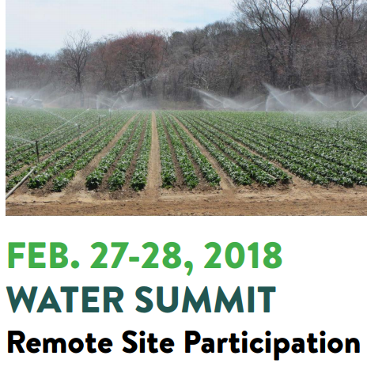
Compliance Timeframe
FSMA PSR proposed compliance
dates for water begin 2022
The reason given for this extension is
“to address questions about the
practical implementation of
compliance with certain provisions
and to consider how we might
further reduce the regulatory burden
or increase flexibility while continuing
to achieve our regulatory objectives,
in keeping with the Administration's
policies”
The Produce Safety Alliance-hosted Water Summit was a forum to discuss concerns and needs
Currently we know little about what, if anything, will change by 2022.
  The following slides are based on our understanding of the current requirements

Slide 10
Current PSR:
Core Requirements for Water
Farms must inspect the agricultural water system,
at least annually
  Identify potential hazards to water quality
  Ensure the system is in good repair
Farms must know the quality of agricultural water
  Routine testing during the growing season
  Quantitative analysis for generic E. coli
Farms must maintain the quality of agricultural water
  “Safe and of adequate sanitary quality for its intended use” and meets numeric criteria for the designated use

Slide 11
Not All Water is Covered
Agricultural water used with a direct water application method to covered produce
  Agricultural water means water used in covered activities on covered produce where water is intended to, or is likely to, contact covered produce or food contact surfaces.
  Direct water application method means using agricultural water in a manner whereby the water is intended to, or is likely to, contact covered produce or food contact surfaces during use of the water.
  Covered produce means produce that is subject to the Produce Safety Rule. The term “covered produce” refers to the harvestable or harvested part of the crop.

Slide 12
Criteria for Production Water
§ 112.44(b): When you use agricultural water during growing activities for covered produce (other than sprouts) using a direct water application method, the following criteria apply (unless you establish and use alternative criteria in accordance with § 112.49): (sub bullets deleted)
Summary
  For water used during production, two statistics based on long-term E. coli test results are used as criteria:
    Geometric Mean of 126 or less CFU/100 mL of water AND
    Statistical Threshold Value of 410 or less CFU/100 mL
Notes:
These same statistics and values can be found in recreational water monitoring.
Don’t get confused by the similarities in the criteria.
The agricultural water criteria are based on a different number of samples, and the samples might be collected in different places and at different times compared with recreational water systems.
Later slides discuss the differences between monitoring strategies between recreational water and agricultural water.
It is important information for laboratories to know what farm monitoring goals are. This affects recommendations about when and where to collect water samples if laboratories address these questions with farms.

Slide 13
More Information About Production Water Criteria
FDA is re-evaluating the criteria and other requirements
There is no single-sample maximum in the Produce Rule
  This is different from some audit standards, like LGMA
  There is no action level other than the calculated statistics
The grower, the lab, or somebody else will need to calculate the statistics (GM and STV) for the farm
  The statistics are calculated similar to the EPA 2012 Recreational Water Quality Criteria but generally use a 4-year data set
    The geometric mean (GM) is a log-scale average, the “typical” value
    The statistical threshold value (STV) is a measure of variability, the estimated “high range” value (approximated 90th percentile)

Slide 14
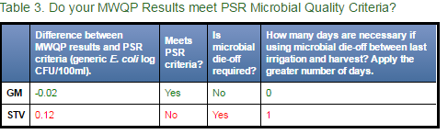
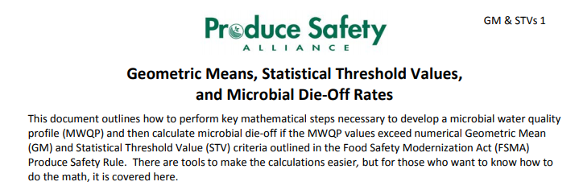
Other Information About Production Water Criteria
The statistics (GM and STV) are called a Microbial Water Quality Profile (MWQP)
  Spreadsheets and extension documents are available
Publicly-Available Calculator Tools
wcfs.ucdavis.edu/
agwater.arizona.edu/
agwater.arizona.edu/onlinecalc/
Produce Safety Alliance Fact Sheet
https://cals.cornell.edu/
produce-safety-alliance/resources

Slide 15
Sampling Production Water
Build a 4-year data set under current PSR system
  For Ground water, 4 or more samples
    Initial set of 4 or more samples over 1 year
    1 new sample added every year, 1 old sample may be dropped
  For Surface water, 20 or more samples
    Initial set of 20 or more samples over 2-4 years
    Ongoing rolling data set includes 4 years’ prior data
    At least 5 new samples added every year
Compare this data set to the 5 samples over 30 days system often used for beaches

Slide 16
Sampling Production Water
Very Important!
To calculate the GM and STV, the sample must be analyzed using a method that results in numbers.
Greater than (>) values, less than (<), ‘present’, or ‘absent’ are not useful since you cannot do calculations with text (non-numeric) results.
This is one reason the water testing method matters. We will discuss methods in a few slides!
Notes:
Note about “less than” values.
In some cases, when no growth is detected in the test, the laboratory must report a “less than” value (the reported result will be “less than” the detection limit of the test, e.g., <1 CFU/100 mL)
This approach is necessary and is dealt with in later calculations by several methods.
One common solution is to use the detection limit as a value for the calculation, and annotating any resulting statistics as “less than;” e.g., geometric mean “less than” 2 CFU/100 mL for a data set where the laboratory results were 8, <1, and <1 CFU/100 mL. The geometric mean of the values 8, 1, and 1 is 2.
In some cases, a laboratory will analyze water samples by testing for total coliforms, then confirm whether the total coliform colonies represent generic E. coli. One example method that follows this strategy is membrane filtration and cultivation on mEndo agar followed by confirmation on NA-MUG agar (SM 9222B/G)
This approach is generally accepted for monitoring E. coli because E. coli is a member of the total coliform group, and should grow on media designed to grow total coliforms.
This approach is used, in particular, for drinking water testing where the presence or concentration of both total coliforms and E. coli is relevant
If the total coliform result is low (e.g., below guideline concentrations such as 126 or 235 CFU/100 mL) some labs will save the time and expense of confirmation and report the concentration of E. coli as “less than” the measured concentration of total coliforms.
This approach, resulting in a “less than” value for E. coli concentration, is not appropriate for agricultural water monitoring when statistics such as geometric mean and statistical threshold value must be calculated based on E. coli concentration.

Slide 17
Criteria for Postharvest Water
§ 112.44(a): When you use agricultural water for any one or more of these following purposes, you must ensure there is no detectable generic Escherichia coli (E. coli) in 100 milliliters (mL) of agricultural water, and you must not use untreated surface water for any of these purposes (sub bullets deleted)
Summary
  For water used during postharvest, E. coli test is required:
    No detectable E. coli in 100 mL water
  Postharvest uses include washing and cooling produce, harvest bin and pack house sanitation (food contact surfaces), hand washing,
  Untreated surface water cannot be used in postharvest even if the water is tested and meets the criterion

Slide 18
More Information About Agricultural Water Test
Different allowed methods for different uses of agricultural water (specific methods detailed later)
  Production water; must use quantitative methods
  Postharvest water; may use either quantitative or presence/absence methods
  FDA has not established hold time requirements
    Use requirements listed in the method, if any.
    If no hold time is listed, one industry standard is the hold time requirement in Standard Methods 9060B
      non-potable water for compliance purposes
        Deliver to laboratory within 6 hours of collection to lab
        Lab must analyze within 8 hours of collection

Slide 19
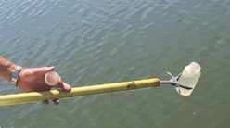
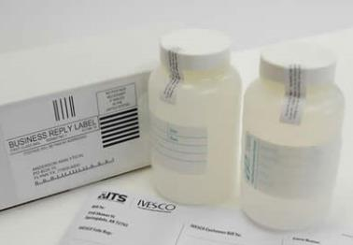
Sampling and Analysis
§ 112.47: You may meet the requirements related to agricultural water testing required under § 112.46 using: (sub bullets deleted)
Summary
  Samples need to be collected properly (aseptic technique)
  Only certain lab testing methods are allowed
Sterile bottles
Sampling
technique

Slide 20
Timing and Location of Sampling
Currently the FSMA PSR says:
  Labs should take care before recommending sampling schedules based on typical drinking, recreational, or wastewater discharge sampling systems
  Understanding agricultural water sampling goals will help the lab make recommendations
  Remember: The proposed compliance dates for water rules (Subpart E, other than sprouts) in the PSR are 2022 or later
§ 112.46(a)(b)(1)(ii): The samples of agricultural water must be representative of your use of the water and must be collected as close in time as practicable to, but prior to, harvest

Slide 21
Test methods
§ 112.151: You must test the quality of water using (a) The method of analysis published by the U.S. Environmental Protection Agency (EPA), “Method 1603 …” or (b) A scientifically valid method that is at least equivalent … in accuracy, precision, and sensitivity; or (c) For any other indicator of fecal contamination … a scientifically valid method
FDA created a list of methods that are considered equivalent
  Similar to, but not the same as, EPA’s lists of approved methods for ambient, drinking, and ground water
  Other methods may also be used if there is scientific information that supports equivalency

Slide 22
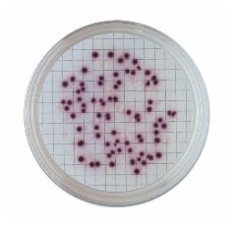
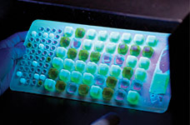
FDA Fact Sheet: Equivalent Water Testing Methodologies (Quantitative)
Notes:
In September 2017, FDA released a fact sheet that recognized several equivalent methods for enumeration of generic E. coli in agricultural water.
The fact sheet states: FDA has determined that the following methods are “scientifically valid” and “at least equivalent to the method of analysis in § 112.151(a) in accuracy, precision, and sensitivity”.
The methods are described in the slide, and references are provided below
The list includes some, but not all, of the EPA-accepted methods for monitoring under the Clean Water Act (often, recreational water monitoring) that are listed in 40 CFR 136.3
Additional Resources:
FDA Fact Sheet 2017. Equivalent Testing Methodologies for Agricultural Water. Available at www.fda.gov/Food/FoodScienceResearch/LaboratoryMethods/ucm575251.htm
EPA 2006. Method 1603: Escherichia coli (E. coli) in Water by Membrane Filtration Using Modified membrane-Thermotolerant Escherichia coli Agar (Modified mTEC). U.S. Environmental Protection Agency. EPA-821-R-06-011
EPA 2010. Escherichia coli (E. coli) in Water by Membrane Filtration Using membrane-Thermotolerant Escherichia coli Agar (mTEC). U.S. Environmental Protection Agency. EPA-821-R-10-002.
APHA 2012. Natural Bathing Beaches (2007). In: Standard Methods for the Examination of Water and Wastewater, 22nd Edition (Rice E.W., et al., Ed.), 9-46 – 9-48. Washington, DC: American Public Health Association. (2012)
ASTM 2000. Standard Test Method for Isolation and Enumeration of Escherichia coli in Water by the Two-Step Membrane Filter Procedure. In: Annual Book of ASTM Standards, Volume 11.02. ASTM International. (1996, 1999, 2000)
Hach Company. Coliforms, Total and E. coli: m-ColiBlue24 Broth PourRite Ampules. Doc316.53.01213, Method 10029, Hach Company
APHA 1997. Standard Total Coliform Membrane Filter Procedure (1997), followed by 9222 G – MF Partition Procedures (1997) using NA-MUG media. In: Standard Methods for the Examination of Water and Wastewater, 21st Edition (Eaton A.D., et al., Ed.), 9-60 – 9-65, and 9-70 – 9-71, respectively. Washington, DC: American Public Health Association. (2005).
EPA 2002. Method 1604: Total Coliforms and Escherichia coli in Water by Membrane Filtration Using a Simultaneous Detection Technique (MI Medium). U.S. Environmental Protection Agency. EPA-821-R-02-024
Idexx, Inc. Colilert. Available at www.idexx.com/water/products/colilert.html
Idexx, Inc. Colilert-18. Available at www.idexx.com/water/products/colilert-18.html

Slide 23
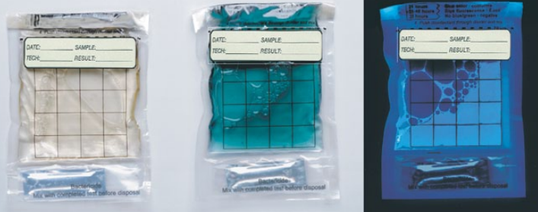
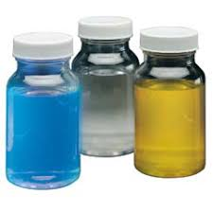
FDA Fact Sheet: Equivalent Water Testing Methodologies (P/A)
Notes:
In July 2018, FDA updated the 2017 fact sheet to recognize presence/absence methods considered suitable for analysis of only postharvest agricultural water.
TECTATM EC/TC medium and the TECTATM Instrument: A Presence/Absence Method for the Simultaneous Detection of Total Coliforms and Escherichia coli (E. coli) in Drinking Water. (2014). Veolia Water Technologies http://technomaps.veoliawatertechnologies.com/tecta/en/
Modified ColitagTM Test Method for the Simultaneous Detection of E. coli and other Total Coliforms in Water. ATP D05-0035. (2009). http://www.colitag.com/
IDEXX Colilert Test Kit https://www.idexx.com/en/water/water-products-services/colilert/
IDEXX Colilert-18 Test Kit https://www.idexx.com/en/water/water-products-services/colilert-18/
IDEXX Colisure Test Kit https://www.idexx.com/en/water/water-products-services/colisure/
E*Colite Bag or Vial Test for Total Coliforms and E. coli in Potable Water. Charm Sciences, Inc. https://www.charm.com/products/test-and-kits/microbial-detection-tests/ecolite-test/
101298 Readycult Coliforms 100. EMD Millipore (division of Merck KGaA, Darmstadt, Germany). https://www.emdmillipore.com/US/en/product/Coliforms-100,MDA_CHEM-101298?CatalogCategoryID=
The image on the top left is a membrane filtration test on modified mTEC; the image on the top right is a Colilert or Colilert-18 most-probable number test on Quantitray 2000. The image on the bottom is E*Colite Bag test (Charm Sciences)
Additional Resources:
FDA Fact Sheet 2018. Equivalent Testing Methodologies for Agricultural Water. Available at www.fda.gov/Food/FoodScienceResearch/LaboratoryMethods/ucm575251.htm
Idexx, Inc. Colilert. Available at www.idexx.com/water/products/colilert.html
Idexx, Inc. Colilert-18. Available at www.idexx.com/water/products/colilert-18.html
Code of Federal Regulations 2018 Alternative Testing Methods for Contaminants Listed at 40 CFR 141.21(f)(6) (E. coli)
Modified Colitag Reference 13: Modified ColitagTM Method, “Modified ColitagTM Test Method for the Simultaneous Detection of E. coli and other Total Coliforms in Water (ATP D05-0035),” August 28, 2009. Available at http://www.nemi.gov or from CPI, International, 580 Skylane Boulevard, Santa Rosa, CA 95403
Code of Federal Regulations 2018 Alternative Testing Methods for Contaminants Listed at 40 CFR 141.402(c)(2) (E. coli)
Readycult reference 20: Readycult® Method, “Readycult® Coliforms 100 Presence/Absence Test for Detection and Identification of Coliform Bacteria and Escherichia coli in Finished Waters,” January, 2007. Version 1.1. Available from EMD Millipore (division of Merck KGaA, Darmstadt, Germany), 290 Concord Road, Billerica, MA 01821
Colilert, Colisure, Colilert-18 referenced as Standard Methods 9223 B
Tecta EC/TC Reference 33: Tecta EC/TC. “TechtaTMEC/TC Medium and TechtaTMInstrument: A Presence/Absence Method for the Simultaneous Detection of Total Coliforms and Escherichia coli (E. coli) in Drinking Water,” version 1.0, May 2014. Available from Pathogen Detection Systems, Inc., 382 King Street East, Kingston, Ontario, Canada, K7K 2Y2
Tecta EC/TC Reference 43: Tecta EC/TC. “TectaTM EC/TC Medium and the TectaTM Instrument: A Presence/Absence Method for the Simultaneous Detection of Total Coliforms and Escherichia coli (E. coli) in Drinking Water,” version 2.0, February 2017. Available from Pathogen Detection Systems, Inc., 382 King Street East, Kingston, Ontario, Canada, K7K 2Y2
Charm Sciences web site
E*Colite Vial Test for Total Coliforms and E. coli in Potable Water: resources.charm.com/file/120
E*Colite: Test for Total Coliforms and E. coli in Potable Water: resources.charm.com/file/89

Slide 24
Summary for the Lab:
What We
Share With the Farmer

Slide 25
Recommendation to Farms:
Test Using Valid Methods
Continue, or start, water testing to understand water quality and/or to meet buyer and audit requirements
Develop water management strategies, such as conducting surveys of water sources, to identify and reduce risks
Test before using the water and during active use periods throughout the season (often 3 times total per year).
Use sterile bottles and aseptic collection technique
Treat the sample right
  Keep it chilled, away from sunlight
  Deliver it to the lab on time, according to the method
    For regulatory monitoring, non-potable water require processing within 8 hours of collection for lab analysis methods that reference Standard Methods 9060B instructions for sample hold time
Notes:
The labs might use these recommendations as a basis for recommendations to their farm clients

Slide 26
Recommendation to Farms:
Communicate with the Lab
Let the lab know you want:
  Analysis for generic E. coli
  A quantitative test, that will give you a number
    Presence/absence OK for postharvest water only.
    Confirm one of the FDA-accepted methods is used.
Ask the lab:
  If they have a sampling kit to send to the farm
    This should include a sterile bottle and sampling instructions
  Instructions for delivery (any limitations on sample receipt)
  What it costs to run a sample
  When the results will come back, for the farm’s records

Slide 27
Recommendation to Farms:
Know What the Results Mean
Use current FSMA PSR requirements as a baseline to think about production water quality:
    Geometric mean 126 or less CFU (MPN) E. coli /100 mL
    Statistical Threshold Value 410 or less CFU (MPN) E. coli /100 mL
  Remember, farmers are only required to begin collecting water before 2022 (largest farms), so these are guidelines. Also be aware buyer may have requirements now.
Postharvest water current FSMA PSR requirement:
  No detectable E. coli in 100 mL water
Encourage farmers to look at all test results so they get a feel for quality over time!
Notes:
Notes:
At the time of this webinar:
Typical FSMA Produce Safety Rule-related visits by inspectors are educational, not inspectional. Inspectional visits are scheduled to begin in 2019.
The proposed rule for extending compliance dates for Subpart E (agricultural water) means that regulatory inspection related to the water-related requirements is not expected until 2022 at the earliest.
FDA is in the process of re-evaluating the water-related requirements, including those described below. The requirements my change prior to 2022.
“Safe and of adequate sanitary quality for its intended use” does not have a quantitative meaning. In the Preamble of the FSMA Produce Safety Rule, FDA references a condition where water would not meet this description. That condition was discovery of a herd of dead and decaying deer in the water source.
MWQP statistics are based on collections of data in the current (June 2018) FSMA Produce Safety Rule including the following:
Untreated surface water: 20 or more samples over 2-4 years (initially) and 20 or more samples over 4 years (rolling)
Untreated ground water: 4 or more samples during 1 year (initially) and 4 or more samples over 4 years (rolling)
If the MWQP calculations shows that production water criteria are not met, the current (June 2018) FSMA Produce Safety Rule requirement is that a farm must:
Stop use of the water as soon as practicable, no later than the following year
Not resume use of the water until one of three corrective measures is implemented
Find the source of contamination, take corrective action to prevent contamination, and confirm that corrective action was effective
Treat the water using an appropriate (e.g., EPA-labeled) chemical treatment (e.g., sanitizer) or treatment device
Apply a log-removal calculation
0.5 log per day removal due to in-field die-off between last application and harvest, no longer than 4 days
Log removal during processing such as commercial washing, with the removal rate supported by data
Log removal during storage, with the removal rate and timeframe supported by data
If the lab result shows that postharvest water criterion is not met, the current (June 2018) FSMA Produce Safety Rule requirement is that a farm must:
Stop use of the water immediately
Not resume use of the water until one of two corrective measures is implemented
Find the source of contamination, take corrective action to prevent contamination, and confirm that corrective action was effective
Treat the water using an appropriate (e.g., EPA-labeled) chemical treatment (e.g., sanitizer) or treatment device

Slide 28
Selected Resources
PSA Fact Sheet The Water Analysis Method Requirement in the FSMA Produce Safety Rule (rev 01/2018 link here)
PSA Fact Sheet Geometric Means, Statistical Threshold Values, and Microbial Die-Off Rates (longhand calculations) (02/17/2017 link here)
Western Center for Food Safety Tools to calculate Geometric Mean and Statistical Threshold Value (UC Davis and University of Arizona link here)
FDA Fact Sheet Equivalent Testing Methodologies for Agricultural Water (07/03/2018 link here)
FDA Question and Answer Sheet FSMA Final Rule for Produce Safety: How Did FDA Establish Requirements for Water Quality and Testing of Irrigation Water? (November 2015; link here)
FDA Proposed Rule Standards for the Growing, Harvesting, Packing, and Holding of Produce for Human Consumption; Extension of Compliance Dates for Subpart E (9/13/17 link here)
Notes:
PSA Fact Sheet The Water Analysis Method Requirement in the FSMA Produce Safety Rule (rev 01/2018
https://resources.producesafetyalliance.cornell.edu/documents/Water-Analysis.pdf)
PSA Fact Sheet Geometric Means, Statistical Threshold Values, and Microbial Die-Off Rates (longhand calculations) (02/17/2017
https://resources.producesafetyalliance.cornell.edu/documents/2017-GM-STV-Worksheet-v1.0.pdf)
Western Center for Food Safety Tools to calculate Geometric Mean and Statistical Threshold Value (UC Davis and University of Arizona
http://wcfs.ucdavis.edu/)
FDA Fact Sheet Equivalent Testing Methodologies for Agricultural Water (9/11/17
https://www.fda.gov/Food/FoodScienceResearch/LaboratoryMethods/ucm575251.htm)
FDA Question and Answer Sheet FSMA Final Rule for Produce Safety: How Did FDA Establish Requirements for Water Quality and Testing of Irrigation Water? (November 2015;
https://www.fda.gov/Food/GuidanceRegulation/FSMA/ucm472501.htm)
FDA Proposed Rule Standards for the Growing, Harvesting, Packing, and Holding of Produce for Human Consumption; Extension of Compliance Dates for Subpart E (9/13/17
https://www.federalregister.gov/documents/2017/09/13/2017-19434/standards-for-the-growing-harvesting-packing-and-holding-of-produce-for-human-consumption-extension)

Slide 29
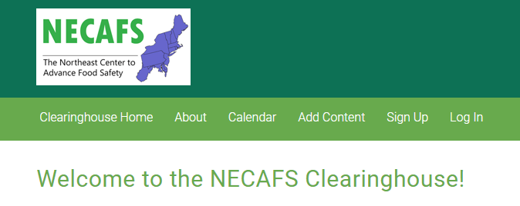
Documentation
The following files will be shared via the NECAFS Clearinghouse after the webinar
  The Michigan State University Procedure for building a map of water analysis labs
  This annotated set of webinar slides, for educational use to describe current FMSA Produce Safety Rule requirements to laboratories
  A recording of the webinar video
Please discard the
draft Procedure,
if you received it,
and replace it with
the final version.

Slide 30

Questions?
Produce Safety Alliance
Don Stoeckel, dstoeckel@cornell.edu
PSA team, producesafetyalliance.cornell.edu
Michigan State University
Marissa Schuh (schuhmar@anr.msu.edu)
Phil Tocco (tocco@anr.msu.edu)
Ben Phillips (phil406@anr.msu.edu)

