Slide 1
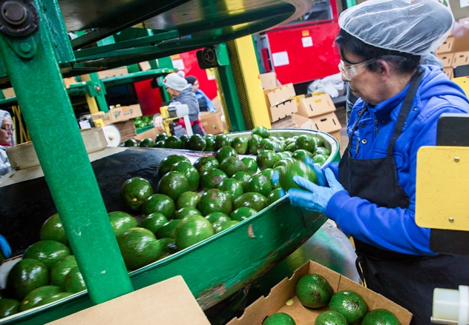
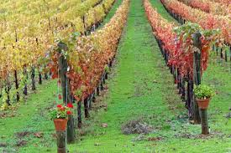
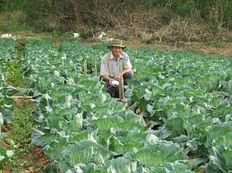
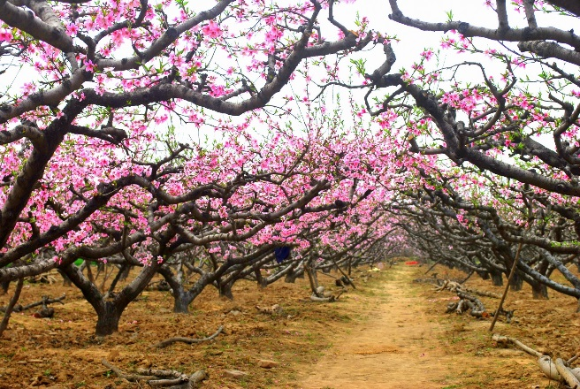
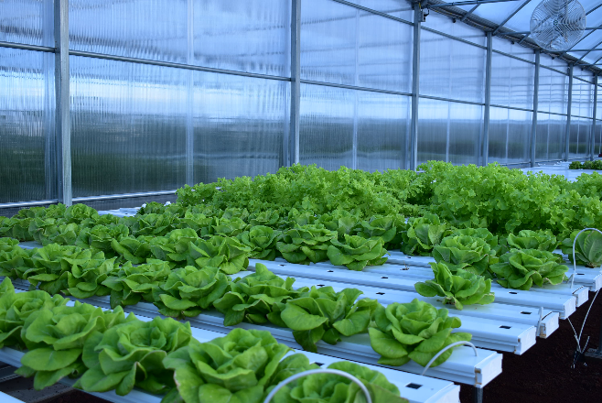
Which FSMA Rule Applies to My Operation?
Important to understand if you are a “Farm” or a “Facility”
Also, important to know FDA is reviewing these definitions
Notes:
This is a supplemental slide that can be presented after Module 1, slide 5 The Food Safety Modernization Act (FSMA).
Trainers may use this opportunity to define Farm and Facility, and reinforce that FDA is reviewing these definitions and they may change. This information may be important for specific farm sectors, such as in large-scale apple or leafy-greens growing areas.
This information is not part of the standardized curriculum because guidance is not enforceable, and subject to change at any time.
The various images are meant to illustrate a variety of ‘typical’ farm settings (not necessarily the full breadth of farms covered under the definition). Original images may be found at the URLs below:
Hydroponic: https://www.af.mil/News/Photos/igphoto/2002187349/mediaid/3699968/ Overview (https://www.af.mil/Disclaimer/) AF.mil is provided as a public service by the Office of the Secretary of Air Force (Public Affairs). Information presented on AF.mil is considered public information and may be distributed or copied. Use of appropriate byline/photo/image credits is requested.
Avocado processing - copyright Produce Safety Alliance, cannot be used for other purposes without permission.
Vineyard: https://pxhere.com/en/photo/158556 The image is released free of copyrights under Creative Commons CC0. You may download, modify, distribute, and use them royalty free for anything you like, even in commercial applications. Attribution is not required.
Harvesting cabbage: https://pxhere.com/en/photo/1094398 The image is released free of copyrights under Creative Commons CC0. You may download, modify, distribute, and use them royalty free for anything you like, even in commercial applications. Attribution is not required.
Peach orchard: https://www.publicdomainpictures.net/en/view-image.php?image=186380&picture=peach-orchard License: CC0 Public Domain Peter Griffin has released this “Peach Orchard” image under Public Domain license. It means that you can use and modify it for your personal and commercial projects. If you intend to use an image you find here for commercial use, please be aware that some photos do require a model or a property release. Pictures featuring products should be used with care.

Slide 2
Farm and Facility Definitions Depend on Activities and Ownership
Farm Activities: grow, harvest, pack, hold, manufacturing/processing (specific, limited)
Primary Production Farms: primarily grow or harvest, may pack or hold
Secondary Activities Farms: primarily harvest, pack, or hold and are not located on the Primary Production Farm property
Ownership: “The primary production farm(s) that grow, harvest, and/or raise the majority of those RACs must own or jointly own a majority interest in the secondary activities farm.”
Notes:
The full definitions of Farm, Facility, and Mixed-type Facility are very lengthy, but are excerpted from the resources and provided below for the convenience of the Trainer using these slides.
Resources:
FDA Guidance Draft Guidance for Industry: Classification of Activities as Harvesting, Packing, Holding, or Manufacturing/Processing for Farms and Facilities accessible at https://www.fda.gov/media/99911/download
FDA Guidance Questions and Answers Regarding Food Facility Registration (Seventh Edition): Guidance for Industry accessible at https://www.fda.gov/media/85043/download
Definitions:
Farm means
(1) Primary production farm. A primary production farm is an operation under one management in one general (but not necessarily contiguous) physical location devoted to the growing of crops, the harvesting of crops, the raising of animals (including seafood), or any combination of these activities. The term “farm” includes operations that, in addition to these activities:
(i) Pack or hold raw agricultural commodities;
(ii) Pack or hold processed food, provided that all processed food used in such activities is either consumed on that farm or another farm under the same management, or is processed food identified in paragraph (1)(iii)(B)(1) of this definition; and
(iii) Manufacture/process food, provided that:
(A) All food used in such activities is consumed on that farm or another farm under the same management; or
(B) Any manufacturing/processing of food that is not consumed on that farm or another farm under the same management consists only of:
(1) Drying/dehydrating raw agricultural commodities to create a distinct commodity (such as drying/dehydrating grapes to produce raisins), and packaging and labeling such commodities, without additional manufacturing/processing (an example of additional manufacturing/processing is slicing);
(2) Treatment to manipulate the ripening of raw agricultural commodities (such as by treating produce with ethylene gas), and packaging and labeling treated raw agricultural commodities, without additional manufacturing/processing; and
(3) Packaging and labeling raw agricultural commodities, when these activities do not involve additional manufacturing/processing (an example of additional manufacturing/processing is irradiation); or
(2) Secondary activities farm. A secondary activities farm is an operation, not located on a primary production farm, devoted to harvesting (such as hulling or shelling), packing, and/or holding of raw agricultural commodities, provided that the primary production farm(s) that grows, harvests, and/or raises the majority of the raw agricultural commodities harvested, packed, and/or held by the secondary activities farm owns, or jointly owns, a majority interest in the secondary activities farm. A secondary activities farm may also conduct those additional activities allowed on a primary production farm as described in paragraph (1)(ii) and (iii) of this definition.

Slide 3
Farm and Facility Definitions Depend on Activities and Ownership
Facility Activities: packing, holding, manufacturing/processing (any)
A facility may consist of one or more contiguous structures, and a single building may house more than one distinct facility if the facilities are under separate ownership.
The private residence of an individual is not a facility
The full definition has additional provisions
Ownership: Under one ownership at one general physical location, or, in the case of a mobile facility, traveling to multiple locations
Notes:
The full definitions of Farm, Facility, and Mixed-type Facility are very lengthy, but are excerpted from the resources and provided below for the convenience of the Trainer using these slides.
Resources:
FDA Guidance Draft Guidance for Industry: Classification of Activities as Harvesting, Packing, Holding, or Manufacturing/Processing for Farms and Facilities accessible at https://www.fda.gov/media/99911/download
FDA Guidance Questions and Answers Regarding Food Facility Registration (Seventh Edition): Guidance for Industry accessible at https://www.fda.gov/media/85043/download
Definitions:
Facility means any establishment, structure, or structures under one ownership at one general physical location, or, in the case of a mobile facility, traveling to multiple locations, that manufactures/processes, packs, or holds food for consumption in the United States. Transport vehicles are not facilities if they hold food only in the usual course of business as carriers. A facility may consist of one or more contiguous structures, and a single building may house more than one distinct facility if the facilities are under separate ownership. The private residence of an individual is not a facility. Nonbottled water drinking water collection and distribution establishments and their structures are not facilities.

Slide 4
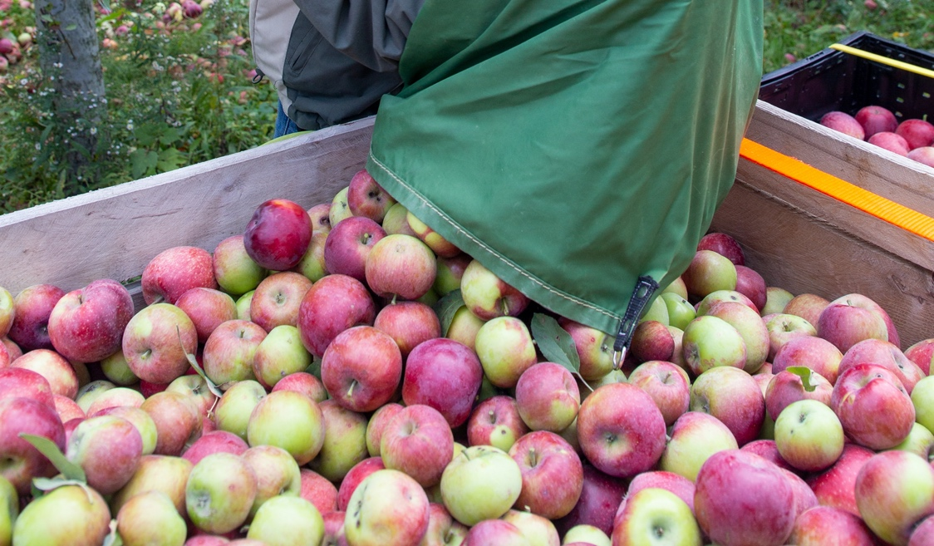
Example: Primary Production Farm
Farm A grows and harvests apples in one general physical location. They also wash their apples in a packinghouse that is separate from the growing area, but still on the same farm.
Notes:
This slide is hidden to shorten the presentation; however, it is provided as a resource for the trainer who might wish to use an example scenario that was created by FDA.
This is an example of an operation that is a primary production farm.
Resources:
FDA Guidance Draft Guidance for Industry: Classification of Activities as Harvesting, Packing, Holding, or Manufacturing/Processing for Farms and Facilities accessible at https://www.fda.gov/media/99911/download
From Page 14: Operation C grows and harvests apples in one general physical location, so Operation C is a primary production farm. Operation C also washes the apples in a packing house that is separate from the growing area but still on the same farm. It also receives apples from another farm under separate management and washes those apples in the same packing house. The washing can be classified as “harvesting.” For the apples the operation grew, this is because the washing is occurring on a farm in the same general physical location as where the apples were grown. For the other farm’s apples, this is because the washing is occurring on a farm in the same general physical location where the farm’s own RACs were grown or raised, and we have removed distinctions from the farm definition that limited what activities farms could perform on RACs from other farms. An activity a farm performs on others’ RACs can be classified the same way as the same activity would be classified when performed on the farm’s own RACs.
Photo attribution: Apple harvesting - copyright Produce Safety Alliance, cannot be used for other purposes without permission.

Slide 5
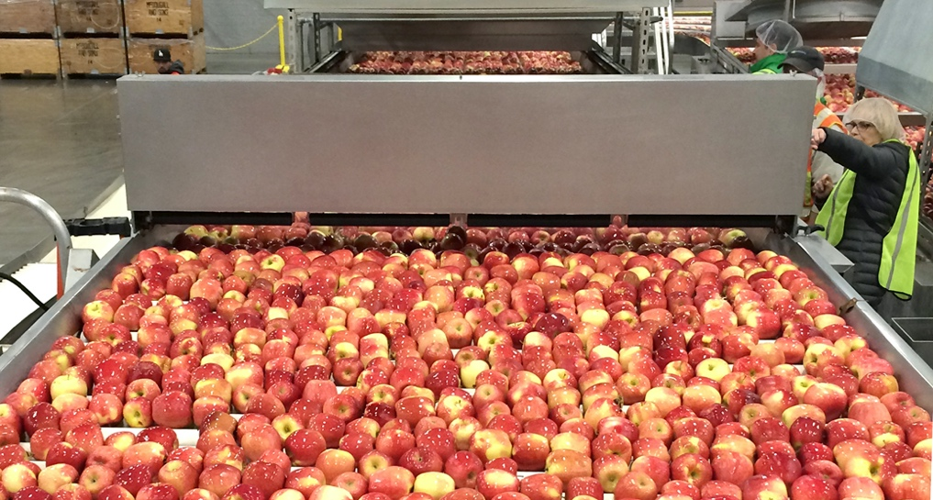
Example: Secondary Activities Farm
Farm B does not grow any apples (or grow/raise any other RACs) but receives apples from multiple farms under separate management and washes them. However, the operation is majority owned by a primary production farm that grows the majority of the apples that Farm B washes.
Notes:
This slide is hidden to shorten the presentation; however, it is provided as a resource for the trainer who might wish to use an example scenario that was created by FDA.
This is an example of an operation that is a secondary activities farm.
Resources:
FDA Guidance Draft Guidance for Industry: Classification of Activities as Harvesting, Packing, Holding, or Manufacturing/Processing for Farms and Facilities accessible at https://www.fda.gov/media/99911/download
A secondary activities farm is an operation, not located on a primary production farm, devoted to harvesting (such as hulling or shelling), packing, and/or holding of raw agricultural commodities, provided that the primary production farm(s) that grows, harvests, and/or raises the majority of the raw agricultural commodities harvested, packed, and/or held by the secondary activities farm owns, or jointly owns, a majority interest in the secondary activities farm.
Page 15: Operation D does not grow any apples (or grow/raise any other RACs) but receives apples from multiple farms under separate management and washes them. The operation is majority owned by the primary production farms that grow the majority of the apples it washes. Operation D is a secondary activities farm. While the washing in this case does not take place in the same general physical location as where any of the apples (or any other RACs) were grown, this is the type of arrangement FDA intended to establish as within the farm definition through the addition of secondary activities farms to that definition. Thus, we consider that in such cases, the criteria in the secondary activities farm definition linking the farms where the RACs were grown to the secondary activities farm (through both the RACs themselves and the majority ownership requirement) make it appropriate to classify such an operation’s washing of apples as “harvesting” even though it is not done in the same general physical location as where the apples (or any other RACs) were grown. (In addition, if some or all of Operation D’s washing is performed for the safe or effective packing of the apples, the washing may also be classified as “packing.”)
Photo attribution: Apple processing - copyright Produce Safety Alliance, cannot be used for other purposes without permission.

Slide 6
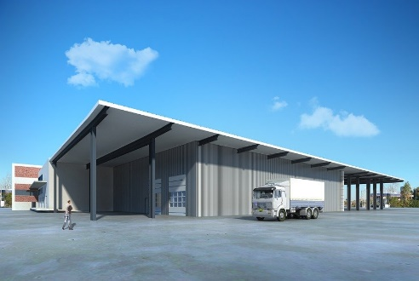
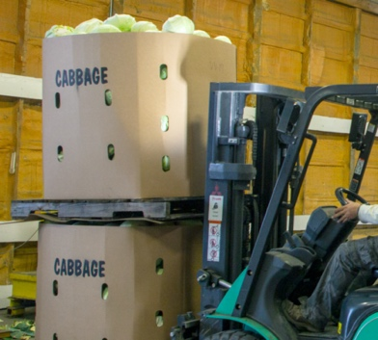
Definition of Farm and Facility Resulted in Different Rules Based on Ownership
Farm
owned
Not Farm
owned
Produce Safety Rule
Preventive Controls Rule
FDA recognizes that “certain activities conducted on produce RACs (Raw Agricultural Commodities) are similar regardless of where they happen” and similar requirements should apply for operations that are farms or facilities.
Notes:
This slide introduces the conundrum in which two operations that do the exact same thing, with the exact same risks to be managed, can be a farm (covered by Produce Safety Rule) or a facility (covered by Preventive Controls Rule for Human Foods). The animation box represents FDA’s recognition of this as a problem which is temporarily addressed with an Enforcement Discretion policy that is introduced on the next slide (Enforcement Discretion for Farm and Facility Definition)
The trainer may choose to use this slide to describe the conundrum before moving into the section describing the Enforcement Discretion policy
Image credits:
Harvesting cabbage: https://pxhere.com/en/photo/1094398 The image is released free of copyrights under Creative Commons CC0. You may download, modify, distribute, and use them royalty free for anything you like, even in commercial applications. Attribution is not required.
Holding operation: https://pixabay.com/photos/warehouse-villa-rendering-1026496/ Pixabay License Free for commercial use No attribution required
Cabbage facility copyright: Produce Safety Alliance, cannot be used for other purposes without permission.
Resources:
FDA guidance Policy Regarding Certain Entities Subject to the Current Good Manufacturing Practice and Preventive Controls, Produce Safety, and/or Foreign Supplier Verification Programs: Guidance for Industry accessible at https://www.fda.gov/media/110023/download
Page 7: Why the enforcement policy is needed
As discussed in more detail below, a threshold question to determine whether and how the regulatory framework provided by parts 117 and 507 applies to an entity is whether the entity is a “farm” as that term is defined in § 1.227 of the section 415 registration regulation. Feedback from regulated entities has raised complex questions about factors, such as farm-related activities and farm ownership, that impact the determination of whether an entity is a “farm.” In addition, we have previously stated our belief that certain activities conducted on produce RACs are similar regardless of where they happen and that an off-farm packinghouse that is subject to the human food preventive controls requirements in part 117 will be able to draw from the provisions of the produce safety regulation in developing its food safety plan and establishing preventive control management components that are appropriate in light of the nature of the preventive controls and their role in the facilities’ food safety system. Feedback from regulated entities has emphasized the need for additional regulatory guidance or changes to the regulatory text to enable this goal to be achieved. In the compliance date final rule, we described these and other questions and extended compliance dates for requirements in part 117 and part 507 as they apply to certain facilities and activities, to consider changes to the regulatory text and better align compliance dates across the regulations. FDA intends to initiate a rulemaking that could change the applicability of the preventive controls and CGMP requirements to some entities that conduct farm-related activities. In the remainder of this guidance, we refer to this rulemaking as the “future rulemaking related to farm activities.” For example, a change to the “farm” definition could change the status of an entity from a facility required to register to a farm. Under the current regulatory framework, a farm is not subject to the preventive controls or CGMP requirements but may be subject to the produce safety regulation, depending on the food and activities involved. We do not anticipate that changes to the regulatory text would result in an entity that currently is a “farm” becoming subject to the preventive controls or CGMP requirements for human or animal food.

Slide 7
Enforcement Discretion for Farm and Facility Definition
Enforcement discretion for Facilities that would qualify as Secondary Activities Farms except for ownership
Important because Facilities are required to establish preventive controls as described in the Preventive Controls Rule for Human Food
Enforcement Discretion means that these facilities do not have to establish preventive controls if they are only doing primary or secondary activities farm practices
The enforcement discretion also allows these facilities to follow handling requirements for Facilities (CGMPs, part 117) or Farms (PSR, part 112)
Notes:
For more information, see pages 10 and 11 of the FDA Guidance Document referenced.
The farm and facility definitions can become difficult to apply with the great diversity of produce operations. For this reason, FDA issued enforcement discretion in 2018 to ensure that the FSMA rules are as effective as possible while providing flexibility where necessary and appropriate to support compliance. This enforcement discretion policy will be in place until the FDA takes further action.
The FDA definition of raw agricultural commodity (RAC) is: “RACs are a food in its raw or natural state, including fruits that are washed, colored, or otherwise treated in their unpeeled form. Grains and eggs are examples of non-produce RACs”
Reference:
FDA guidance Policy Regarding Certain Entities Subject to the Current Good Manufacturing Practice and Preventive Controls, Produce Safety, and/or Foreign Supplier Verification Programs: Guidance for Industry accessible at https://www.fda.gov/media/110023/download

Slide 8
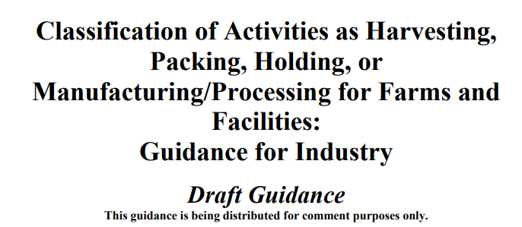
Activities Affect Operation Status as Farm or Facility
FDA published guidance to describe current thinking on topics such as activities and definitions
Farms: Growing, harvesting, packing, holding, manufacturing/processing (limited and specific)
Facilities: Packing, holding, manufacturing/processing
Notes:
Resources:
FDA Guidance Draft Guidance for Industry: Classification of Activities as Harvesting, Packing, Holding, or Manufacturing/Processing for Farms and Facilities accessible at https://www.fda.gov/media/99911/download

Slide 9
How Activities Affect Operation Status
Facilities: Pack, Hold, Manufacture/Process
Manufacturing/Processing activities generally make an operation fall under the definition of a facility
For example, chopping, freezing, thermal processing
A few specific Manufacturing/Processing activities can be done at a farm (under the farm definition)
Only packaging and labeling, dehydrating and drying that does not result in a distinct commodity, or treatment for ripening
Other Manufacturing/Processing activities can be done at a farm under enforcement discretion
Coloring produce RACs, or
Packing, packaging, labeling, or holding of dried/dehydrated RACs that are a distinct commodity (e.g., dried beans)
Notes:
The full definitions of Farm, Facility, and Mixed-type Facility are very lengthy, but excerpted from the resources and provided below for convenience.
Resources:
FDA Guidance Draft Guidance for Industry: Classification of Activities as Harvesting, Packing, Holding, or Manufacturing/Processing for Farms and Facilities accessible at https://www.fda.gov/media/99911/download
FDA Guidance Questions and Answers Regarding Food Facility Registration (Seventh Edition): Guidance for Industry accessible at https://www.fda.gov/media/85043/download
FDA constituent update At this time, FDA does not intend to enforce certain provisions in four regulations implementing FSMA. Which provisions and why? accessible at https://www.fda.gov/media/110052/download
Definitions:
Facility means any establishment, structure, or structures under one ownership at one general physical location, or, in the case of a mobile facility, traveling to multiple locations, that manufactures/processes, packs, or holds food for consumption in the United States. Transport vehicles are not facilities if they hold food only in the usual course of business as carriers. A facility may consist of one or more contiguous structures, and a single building may house more than one distinct facility if the facilities are under separate ownership. The private residence of an individual is not a facility. Non-bottled water drinking water collection and distribution establishments and their structures are not facilities.
Mixed-type facility means an establishment that engages in both activities that are exempt from registration under section 415 of the Federal Food, Drug, and Cosmetic Act and activities that require the establishment to be registered. An example of such a facility is a “farm mixed-type facility,” which is an establishment that is a farm, but also conducts activities outside the farm definition that require the establishment to be registered.

Slide 10
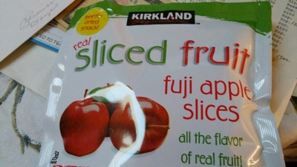
Summary of Activities and Enforcement Discretion for Definitions
Ownership is part of FDA’s farm definition enforcement discretion, but most activities are not
Most Manufacturing/Processing activities at an operation still trigger coverage by the Preventive Controls Rule
For example:
Slicing apples for individual servings
Cutting and mixing lettuces with other commodities to create a packaged salad
A facility (under the existing definition) must still register with FDA
Notes:
Photo attribution: Photo by openfoodfacts-contributors per Open Food Facts
Image under creative commons license (https://creativecommons.org/licenses/by-sa/3.0/deed.en): https://world.openfoodfacts.org/product/0096619662067/fuji-apple-slices-kirkland

Slide 11
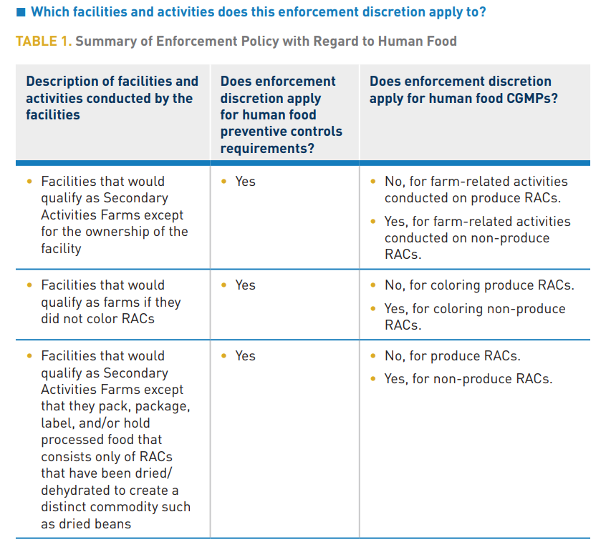
Hyperlink to Fact Sheet
Notes:
The full description of enforcement discretion scope and application is complex. The information is captured in two tables (one for Human Food, one for Animal Food) on pages 2 and 3 of the referenced FDA stakeholder update. A fact sheet that includes the table shown can be found in the PSA Grower Training manual V 1.2 (page 39 FDA/USDA resources in v1.2 PSA Grower Training Manual). It might be useful to walk through the table with course participants.
Consider handing out or viewing Table 1 from the referenced document (thumbnail in the slide for illustration; hyperlinked to https://www.fda.gov/media/110052/download#page=2 for the trainer’s convenience)
Column 1 relates to facilities and activities
Facilities that would qualify as Secondary Activities Farms except for the ownership of the facility
Facilities that would qualify as farms if they did not color RACs
Facilities that would qualify as Secondary Activities Farms except that they pack, package, label, and/or hold processed food that consists only of RACs that have been dried/dehydrated to create a distinct commodity such as dried beans
Farm mixed-type facilities making silage food for animals (only relevant to animal foods)
Column 2 relates to whether the enforcement discretion applies to Preventive Controls requirements (Human or Animal Foods, respectively)
Column 3 relates to whether enforcement discretion applies to CGMPs (Human or Animal Foods, respectively)
In general, the enforcement discretion applies to all situations listed except that CGMPs are required for produce RACs (as human food).
Reference:
FDA constituent update At this time, FDA does not intend to enforce certain provisions in four regulations implementing FSMA. Which provisions and why? accessible at https://www.fda.gov/media/110052/download

